Slide 1


Slide 2


Slide 3
GAS LEVEL DETECTION AND AUTOMATIC BOOKING SYSTEM
TEAM MEMBERS:
SOWMIYA . V (927622BEC198)
SRIMATHIDEVI . P (927622BEC203)
SRINITHI . P (927622BEC205)
VANISHA . R (927622BEC240)
GUIDED BY :
Ms .S .VASUKI

Slide 4
CONTENT :
INTRODUCTION
PROBLEM STATEMENT
OBTECTIVE
EXISTING SYSTEM
BLOCK DIAGRAM
HARDWARE TOOL
SOFTWARE TOOL
PLAN OF WORK COMPLETION
CONCLUSION
REFERENCE

Slide 5
INTRODUCTION :
In our fast-paced world, convenience is key. Whether it's managing household tasks or ensuring industrial efficiency, the demand for streamlined processes has never been higher.
One area where this demand is particularly evident is in the monitoring and replenishing of gas supplies.
Traditional methods of gas level monitoring and booking have often been manual, time-consuming, and prone to errors.
However, with advancements in technology, we now stand at the brink of a revolutionary solution – the Gas Level Detection and Automatic Booking System.

Slide 6
Imagine a system that can accurately monitor gas levels in real-time, notifying users when it's time for a refill, and even autonomously scheduling deliveries.
This system ensures that users never run out of gas unexpectedly.

Slide 7
PROBLEM STATEMENTS:
Gas supply management is a critical aspect of various sectors, including households, industries, and commercial establishments. However, the traditional methods of monitoring gas levels and placing orders suffer from inefficiencies and shortcomings, leading to frequent inconveniences and disruptions. The need of the hour is to develop a comprehensive solution that addresses these challenges and provides a seamless experience for users.
Manual Monitoring and Ordering
Unpredictable Consumption Patterns
Inefficient Inventory Management
Customer Convenience and Satisfaction

Slide 8
OBJECTIVES:
The primary objective of this project is to develop a Gas Level Detection and Automatic Booking System that addresses the aforementioned challenges and delivers the following benefits.
Real-Time Monitoring: Implement sensors and IoT technology to enable real-time monitoring of gas levels in cylinders or tanks, providing users with accurate and timely information.
Automatic Booking: Develop algorithms and scheduling mechanisms to automatically generate refill orders based on level detected by the load cell.

Slide 9
Gas Leakage Detection : The objective of a gas sensor for LPG is to detect any leakage of gas from the system or storage containers.
Early Warning System: Gas sensors aim to provide an early warning in case of gas leakage, allowing users to take prompt action to mitigate the risk

Slide 10
EXISTING SYSTEM
The level of LPG is measured using the load sensor. The output of the sensor is connected with Arduino UNO. By the use of the NODE MCU, the information is sent to the user by IOT server and also automatic booking is done by IOT server .
Then the gas leakage is detected by the gas sensors (MQ-6).The warning is given by IOT server through notifications

Slide 11
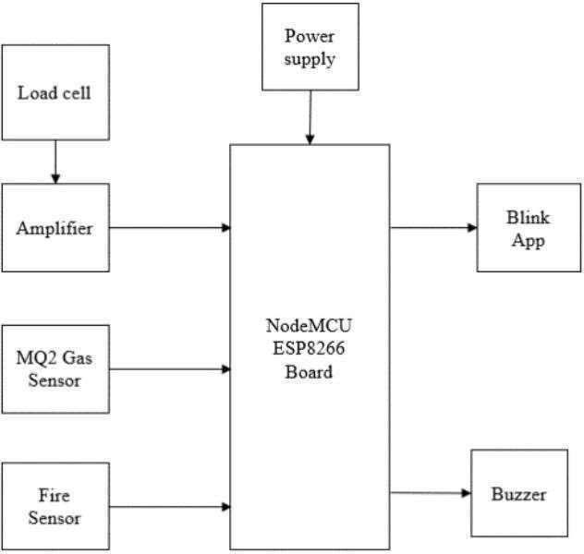
BLOCK DIAGRAM :

Slide 12
HARDWARE TOOLS
Arduino uno
Gas Sensor (MQ-6)
LPG Cylinder
Node MCU
Load Cell(10 kg)
Buzzer
LED Display

Slide 13
SOFTWARE TOOLS
Arduino IDE
Embedded-C
IOT Server

Slide 14
PLAN OF WORK COMPLETION:
Objective Definition
Team Formation
Resource Allocation
Research and Requirements Gathering
System Design and Architecture
Hardware Development
Software Development
implementation and testing
Monitoring and Maintenance
Documentation and Knowledge Sharing

Slide 15
CONCLUSION:
By using gas level detection and automatic booking system automatic booking is possible which helps for prebooking.
By using gas sensor we can detect the leakage and avoid the fire accident.

Slide 16
REFERENCE:
Conference Proceedings:"IoT-Based Gas Cylinder Monitoring and Booking System" presented at the International Conference on Internet of Things and Cloud Computing."Design and Implementation of IoT-Based Gas Level Detection and Automatic Booking System" presented at the IEEE International Conference on Computing, Communication, and Automation.
Research Papers : "Design and Implementation of IoT-based Gas Level Monitoring and Booking System" by S. Ghosh, A. Paul, and S. K. Das."IoT-Based Gas Cylinder Monitoring and Booking System" by N. K. Jha, S. Kumar, and A. Gupta.
Journals:"An IoT-Based Intelligent Gas Monitoring and Booking System" by S. K. Chaurasia and A. A. Bhat."Smart Gas Cylinder Management System Using IoT and Cloud Computing" by S. Sahoo and A. K. Patra.

Slide 17


